Slide 1
HSBP Senior Survey

Slide 2
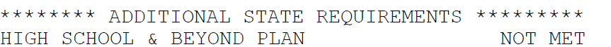
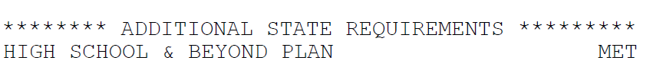
Your High School & Beyond Plan
Your High School & Beyond Plan is a graduation requirement.
Shows up on your official transcript as MET
Complete the short survey in Naviance each year through grade 12.

Slide 3



Log in to Naviance Student
Click Students from school website
Click Naviance button
Log in with district ID# and password
Naviance Student
Username: district ID#
Password: district password

Slide 4
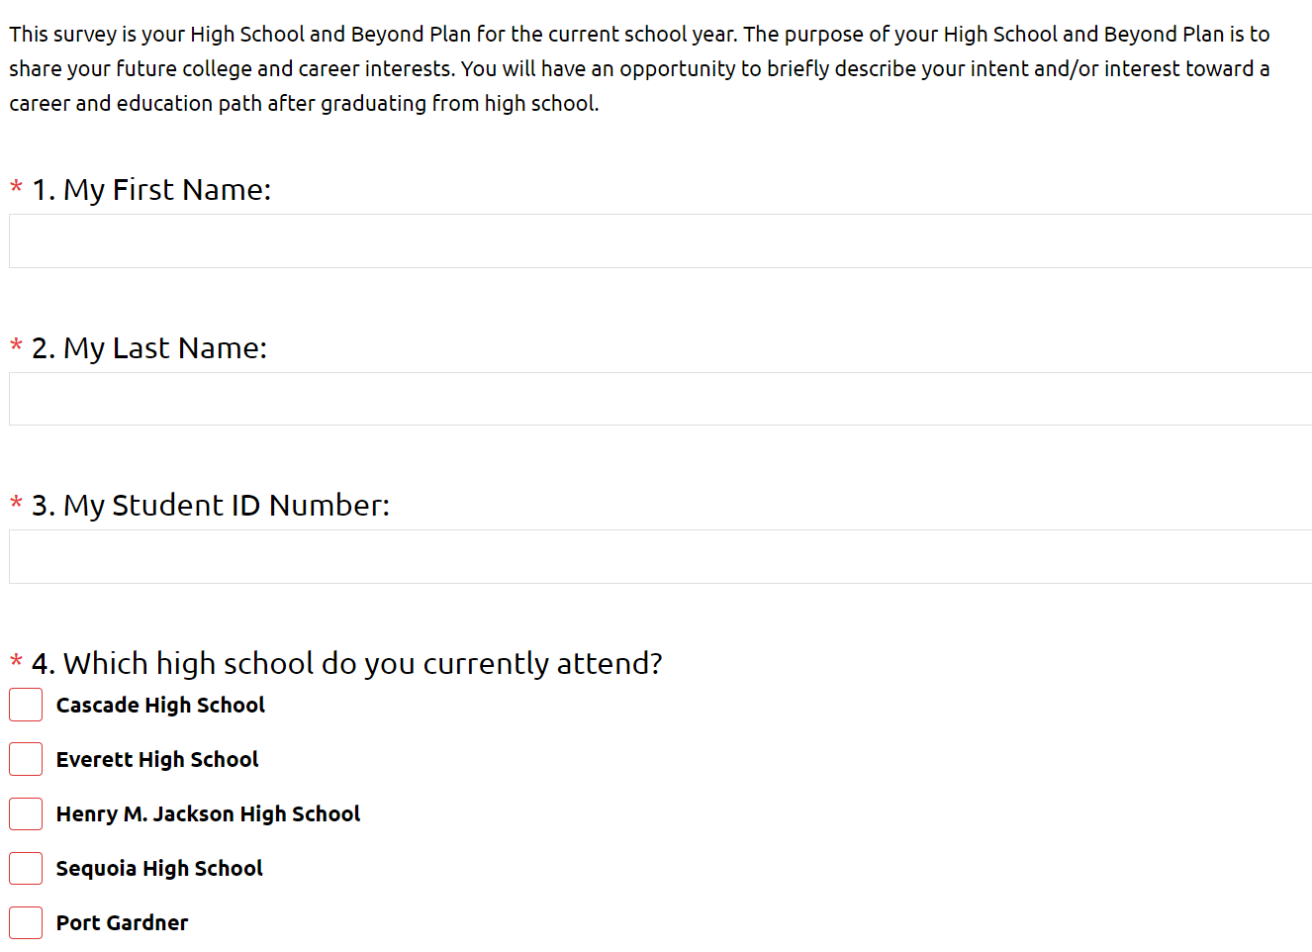
Survey Questions
Answer the questions on the My High School and Beyond Plan Senior Year survey
Notice the questions marked with a red asterisk * are required questions

Slide 5
Math & ELA Pathway Questions
Math Graduation Pathways: Meet standard on math Smarter Balanced Assessment Complete and qualify for college credit in a dual credit math course Earn credit in a high school math transition course (Bridge to College) Earn a C+ or higher in a qualifying AP math course OR 3 or higher on an AP Math exam Meet standard on SAT OR ACT in math Meet standard on the Armed Service Vocational Aptitude Battery (ASVAB) Complete a qualifying sequence of career and technical (CTE) courses Meet Standard on math WA-AIM
ELA Graduation Pathways: Meet standard on ELA Smarter Balanced Assessment Complete and qualify for college credit in a dual credit math course Earn a C+ or higher in a qualifying AP ELA course OR 3 or higher on an AP ELA exam Meet standard on SAT OR ACT in reading, writing, or English Meet standard on the Armed Service Vocational Aptitude Battery (ASVAB) Complete a qualifying sequence of career and technical (CTE) courses Meet Standard on ELA WA-AIM
For the pathway questions, please mark one or more graduation pathways if they apply to you.
If you are unsure or have a graduation pathway question, please email your counselor to set up an appointment.

Slide 6
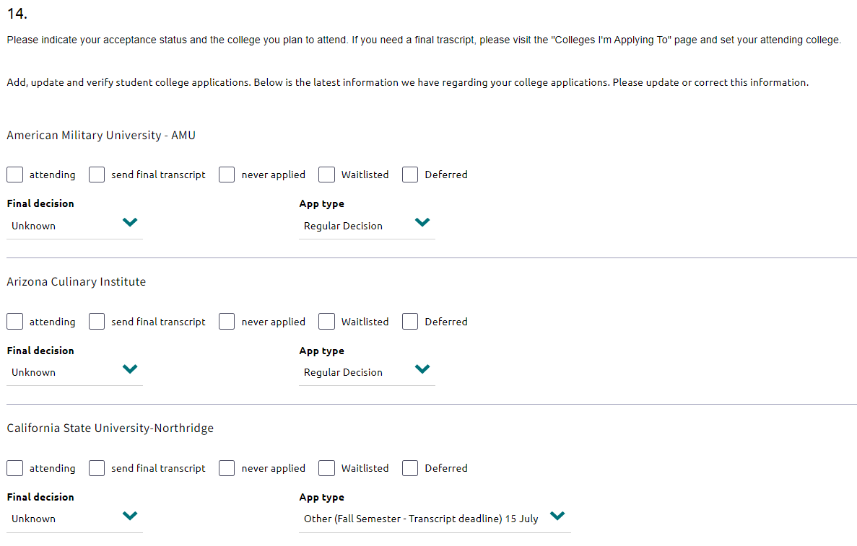
Questions
When answering questions about your college choice please indicate your acceptance status if you know.
If you are still deciding, you can update this later.

Slide 7
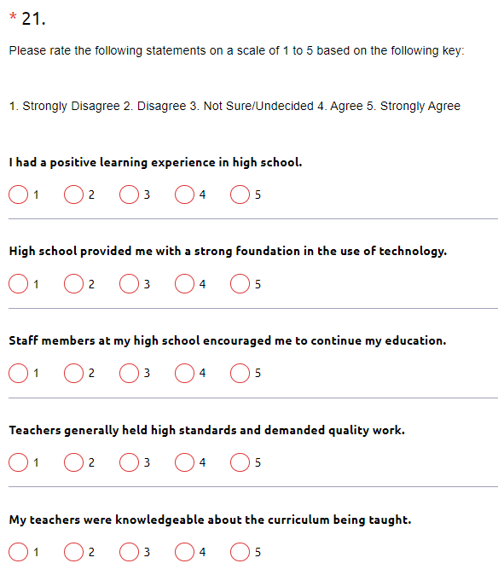
Questions
For questions using a scale, answer the questions using a1-5 rating
1 - Strongly Disagree
5 - Strongly Agree

Slide 8
Task Completion…

Slide 9
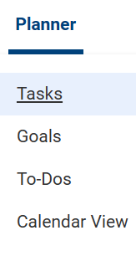
Complete the Task…
To complete the lesson task log into Naviance Student, click on Planner > Tasks.
Click the title of the task – CCRS - Complete FALL Senior Yr. High School & Beyond Plan Survey

